Slide 1
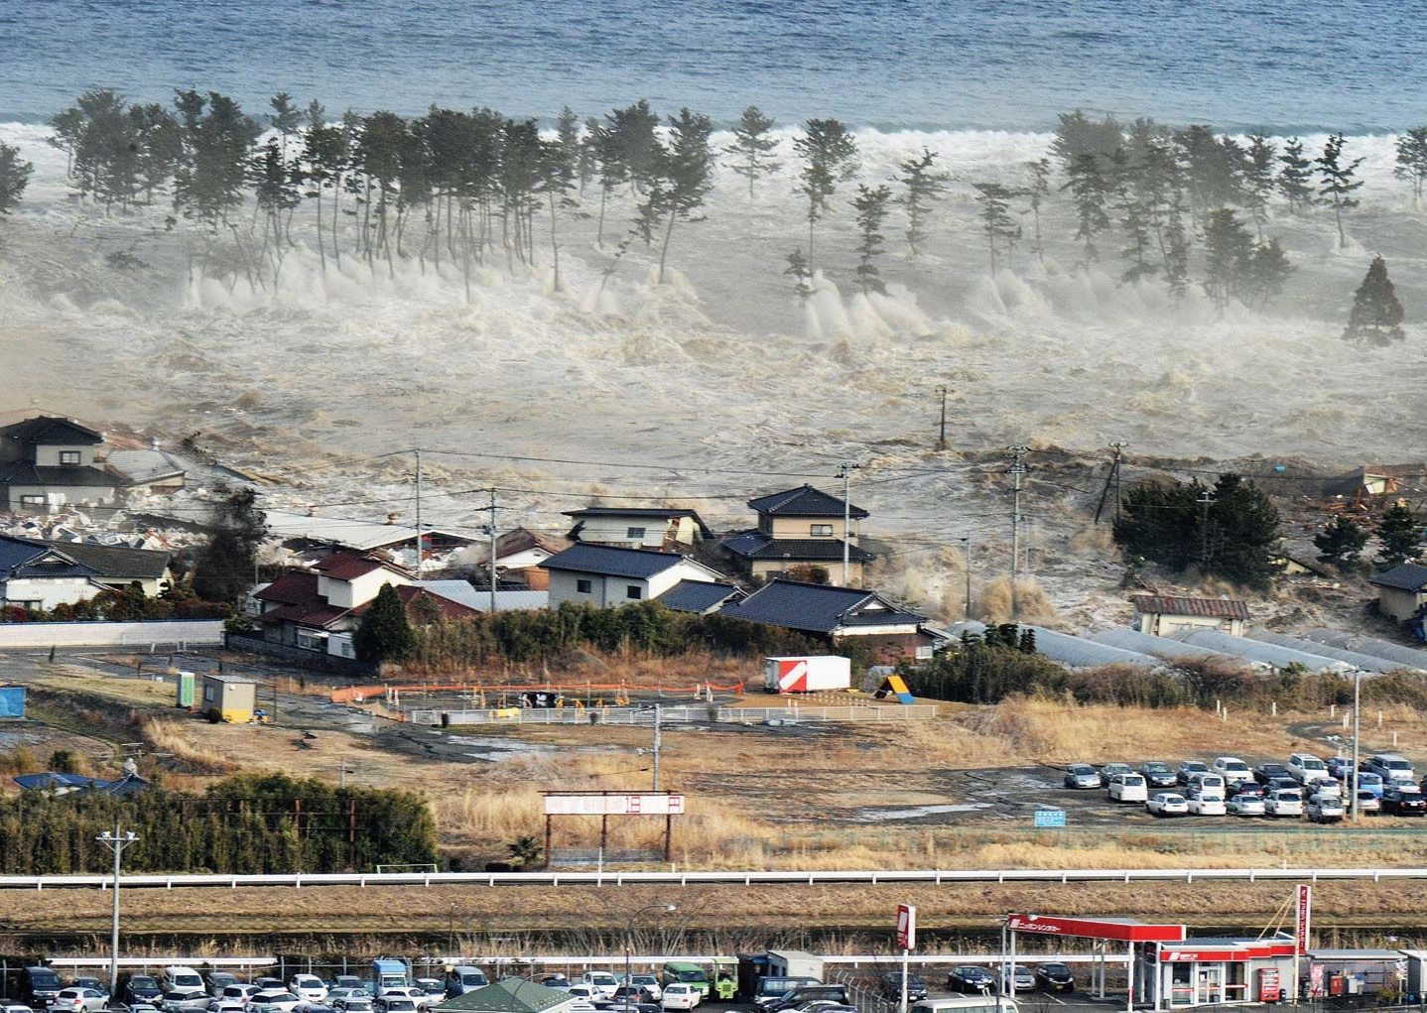
Earthquakes of 2010-2023:
Project 1 Group 6

Slide 2
Objectives
Assumptions and Filters
To reduce the size of the dataset, we’ve needed to filter out earthquakes from the data retrieval. We are:
restricting earthquake magnitude to greater or equal to 5
retrieving data from 2010-2023
filtering out earthquakes with a recorded depth of greater than 100km
Retrieve earthquake data from various open API sources
Record the number of earthquakes across different countries. Rank the 10 top countries by the number of earthquakes and through time. Analyse the spatial distribution of the number of earthquakes.
Investigate the frequency of earthquakes per month and year. Analyse this spatially
Note: in answering this question we thought there was some redundancy with the previous question so was not pursued
Look at the distribution and spatial characteristics of the magnitudes of earthquakes. Is there any correlation between earthquake magnitude and depth?
Investigate what are the relationships between magnitude of earthquake and causality rates and determine which countries are most affected. Is there a relationship between causality rates and a countries economic status?
Stretch Question: Is it possible to correlate tidal fluctuations with earthquake occurrence
Note: Not enough time to investigate

Slide 3
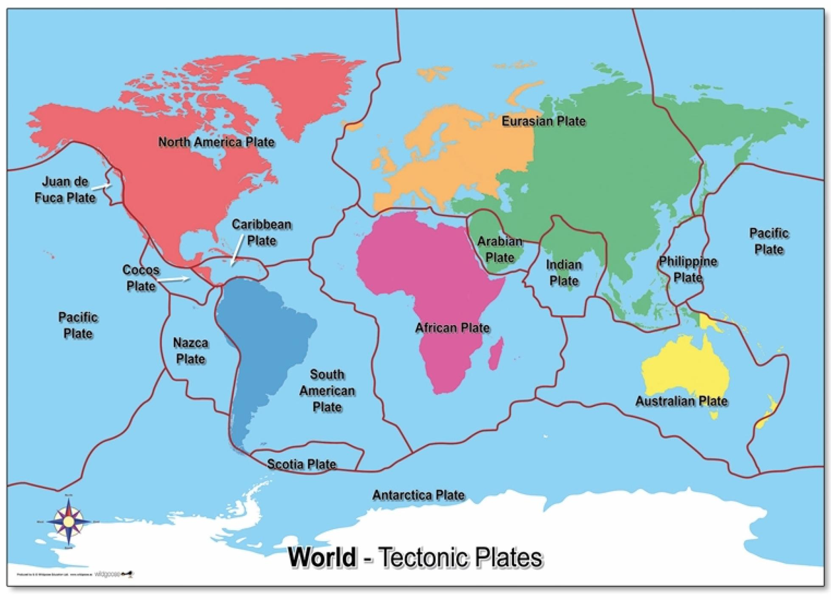
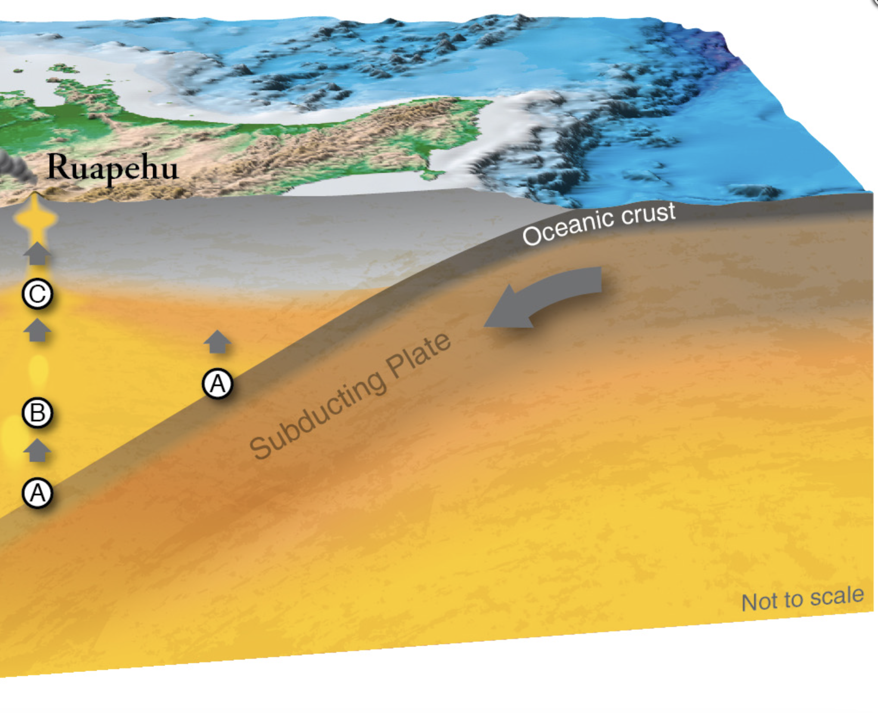
What is an earthquake?
https://wildgooseeducation-static.myshopblocks.com/images/2018/11/contain/2048x2048/98223b5c43ffb4d324090f8bf1853641.jpg
https://www.seismicresilience.org.nz/topics/seismic-science-and-site-influences/seismicity-in-new-zealand/

Slide 4
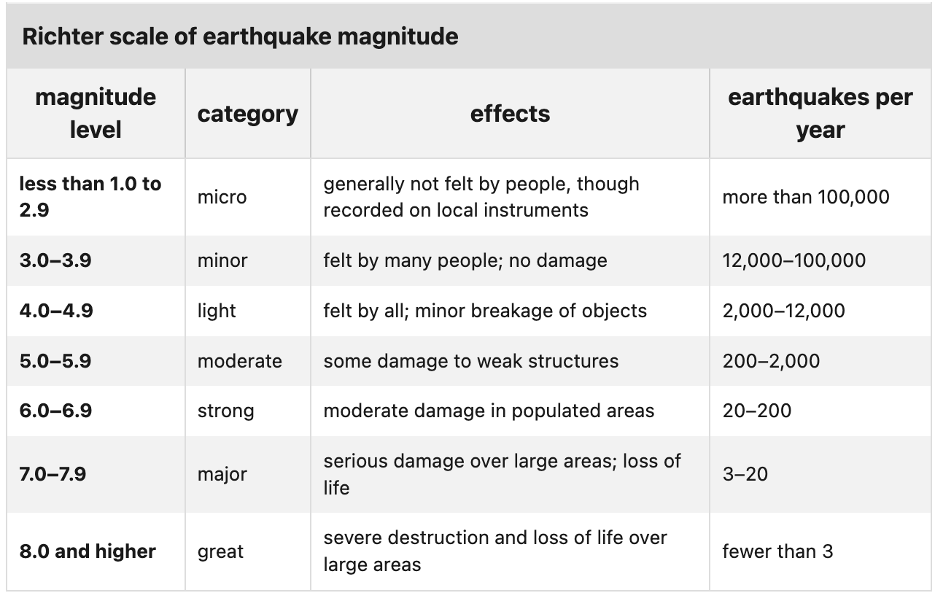
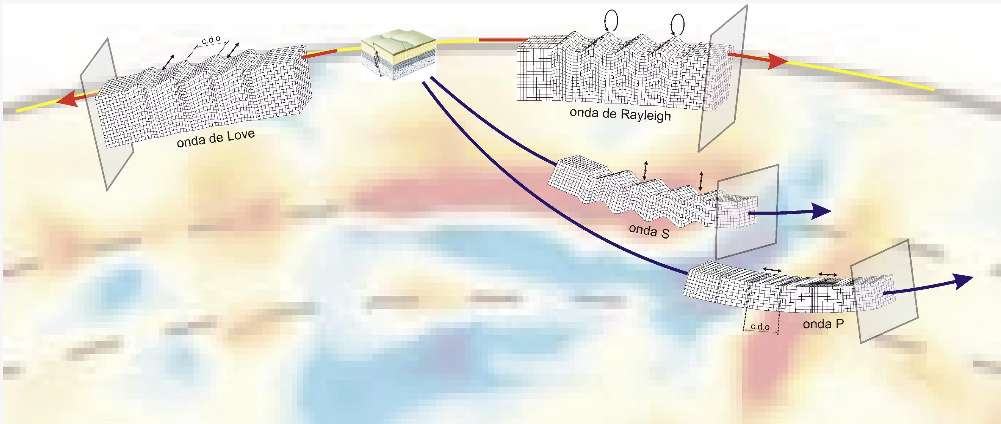
How do we measure and classify earthquakes?
Earthquakes are measured at seismic stations with seismographs
Earthquake magnitude is a measure of:
the “amplitude” or ”size” of recorded earthquake wave
Normalised to 100km from the epicentre
Magnitude is in logarthimic scale (base 10) called the Richter scale
Relationship between magnitude and energy is unclear. E.g. energy released for a magnitude 7 earthquake is 32 times greater than a magnitude 6 earthquake
https://www.britannica.com/science/earthquake-geology/Earthquake-magnitude
https://lisbonquake.com/en-GB/blog/the-four-types-of-seismic-waves

Slide 5

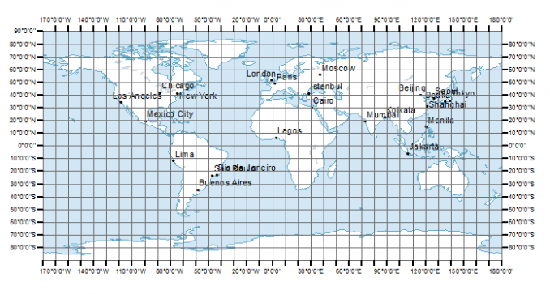



Data retrieval
Data Sources
Map of 10-degree bins of latitude and longitude for USGS earthquake retrieval
United States Geological Survey: API
Earthquake Data Retrieval
Natural Earth.com: Shapefile
Country Outlines and Geographic & Economic Data
Our World in Data.org: csv
Earthquake casualty statistics and economic impacts
GeoPy: Python Module API
Geocoding web services for earthquake location information

Slide 6
Earthquake Analysis by Country
Number of earthquakes across different countries from 2010 to 2023
Top 10 countries with number of earthquakes including the extended borders
Spatial distribution of the number of earthquakes

Slide 7
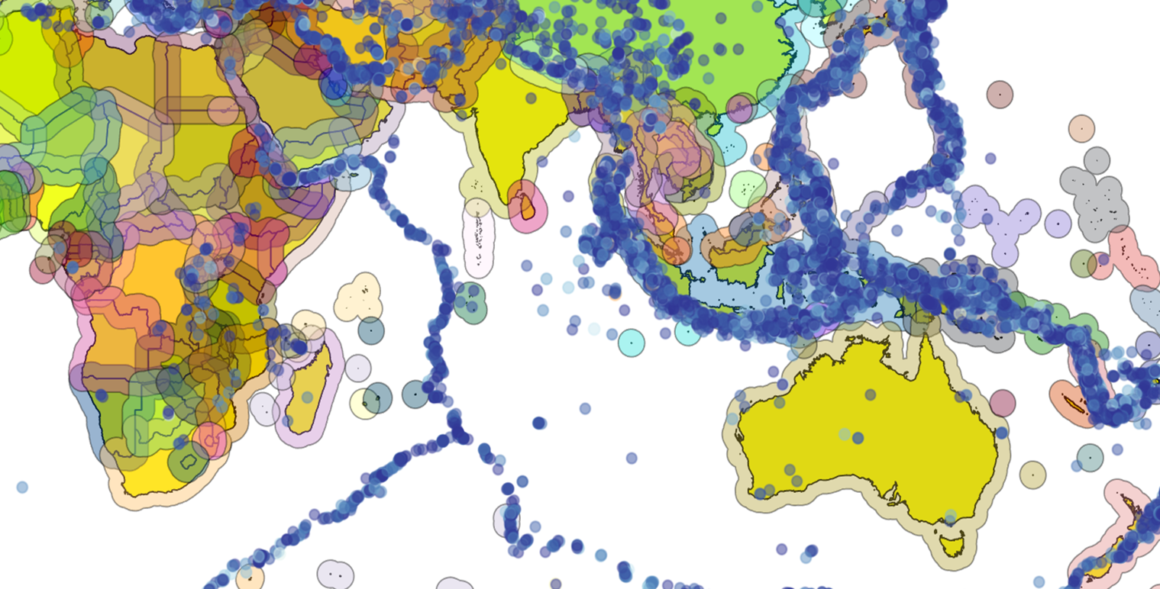
What is On Land and Extended Border ?
Land
Ext Borders

Slide 8
Filtered the data of earthquakes into two parts - on land(countries) - on extended borders(within the 2 degrees)
Total number of earthquakes on land - 8194
Total number of earthquakes including extended border - 24161

Slide 9
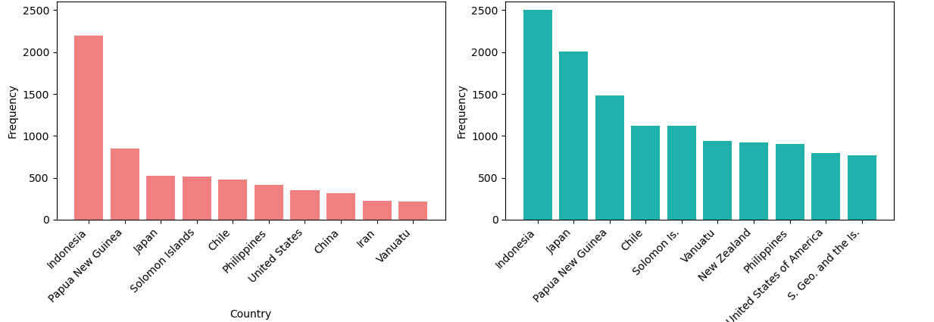
Top 10 countries with highest frequency of earthquakes

Slide 10
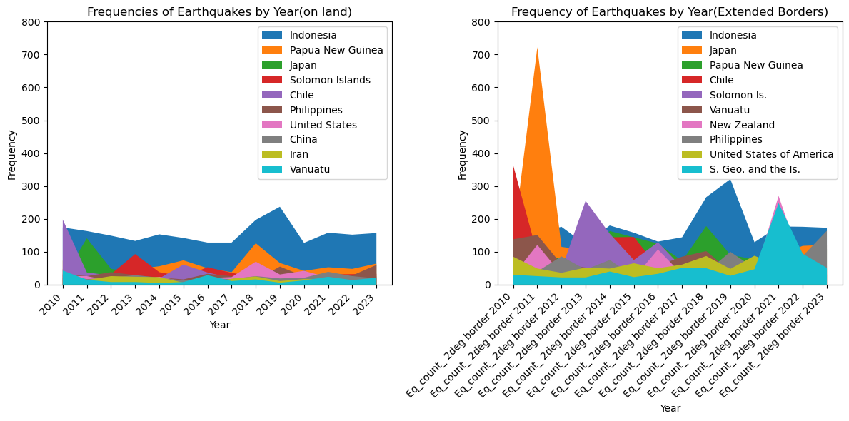
Highest frequency of earthquakes by year

Slide 11
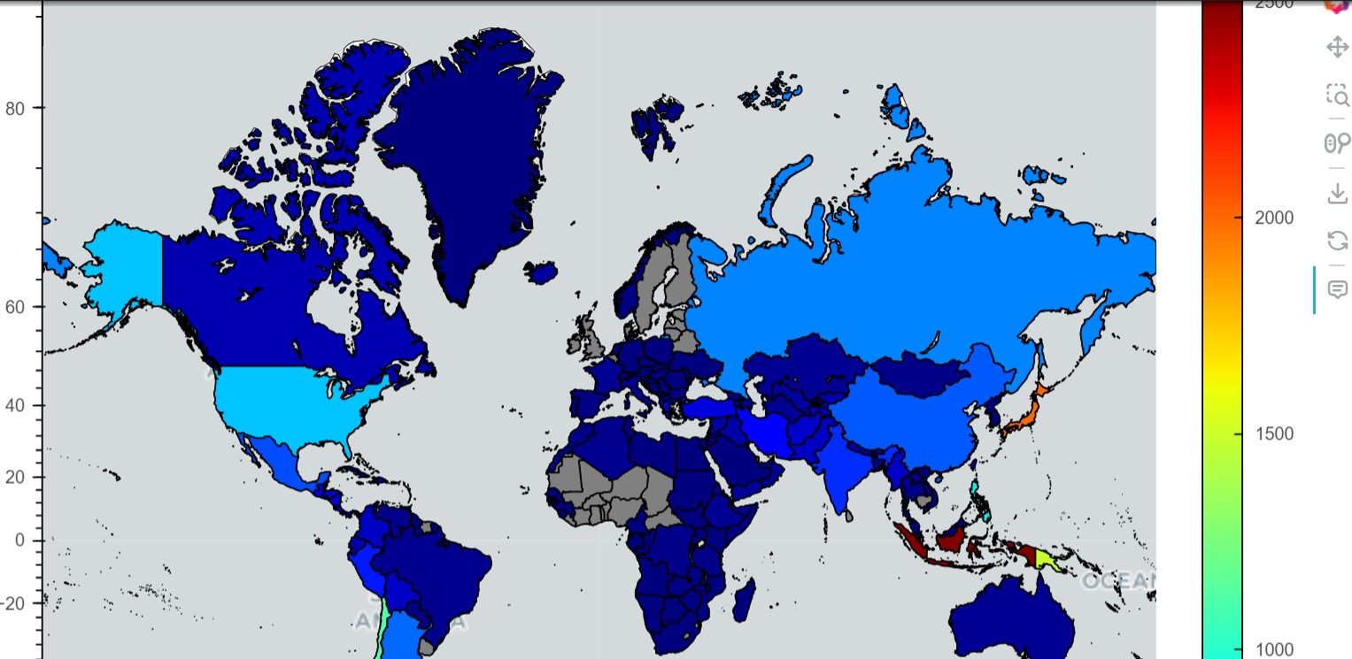
Spatial view of the Earthquake Frequency

Slide 12
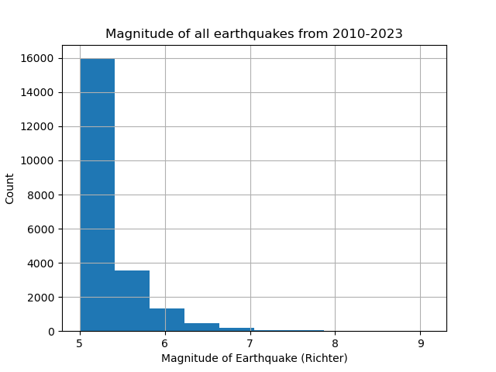
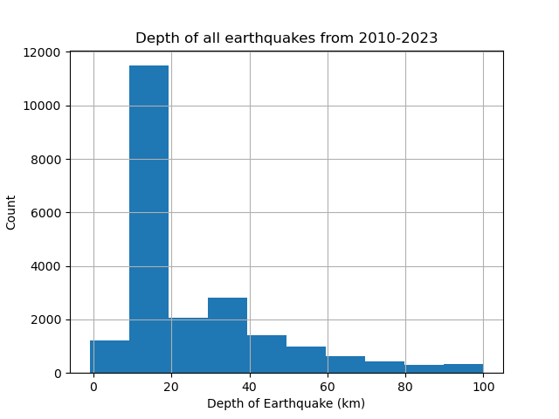
Magnitude (>5) & Depth (<100km) of all earthquakes from 2010 to 2023
The graph shows small magnitude(between 5 and 6) of earthquakes occur more frequently
Skewed to the left.
The graph shows the most frequent occurrence of earthquakes between 2010 and 2023 are in a depth of below 20 km.
The earthquakes with a depth between 20 and 40 km rank 2nd in terms of frequency.
Some earthquakes occur in the depth between 40 and 60 km while other earthquakes with different depths are less apparent.

Slide 13
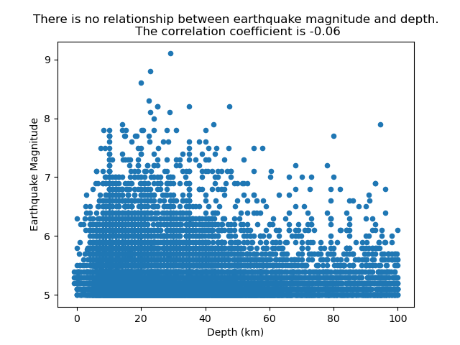
Is There a Relationship Between Depth and Magnitude?
The graph shows there is no significant relationship between earthquake magnitude and depth since the correlation coefficient is -0.06.

Slide 14
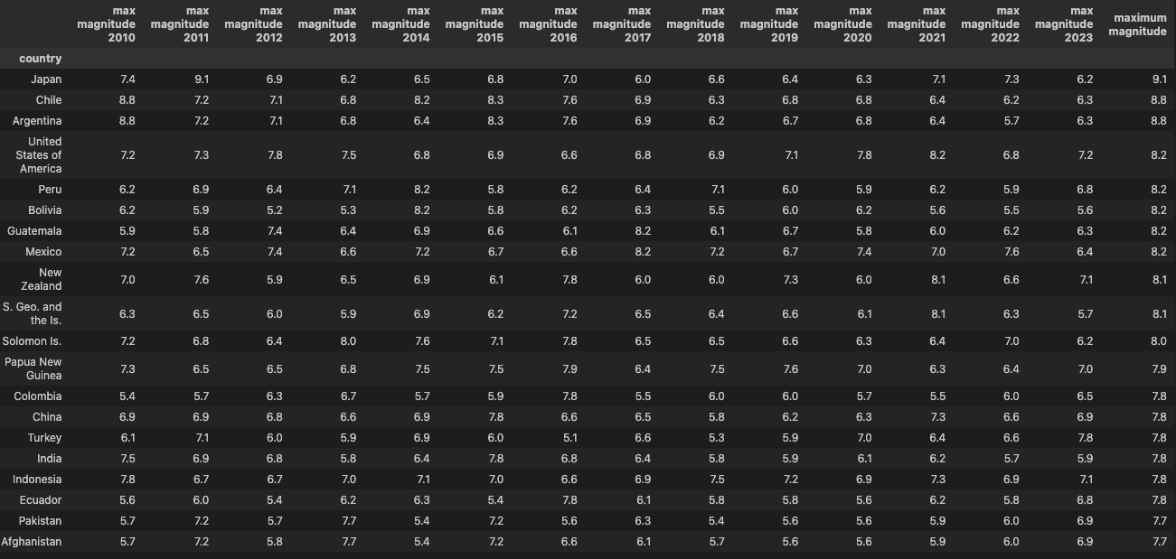
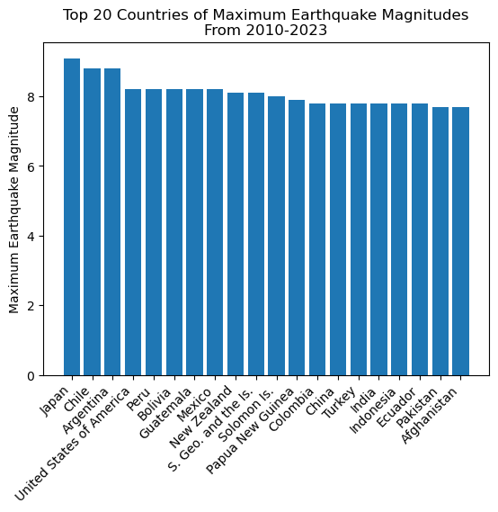
Ranking Magnitude By Country
Top 20 Magnitude Earthquakes
Maximum Earthquake Magnitude Per Country Through 2010-2023
Highest magnitude earthquake occurred in Japan 2011. Tsunami disaster and nuclear meltdown event

Slide 15
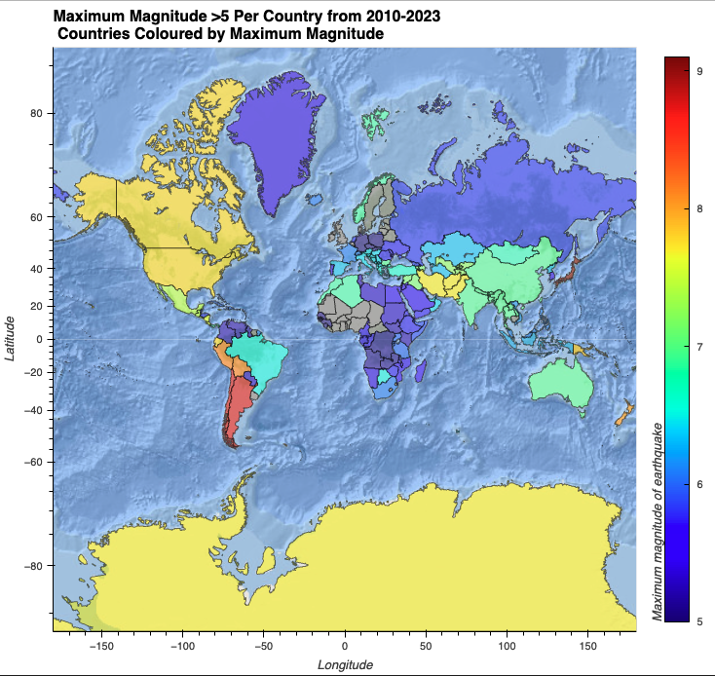
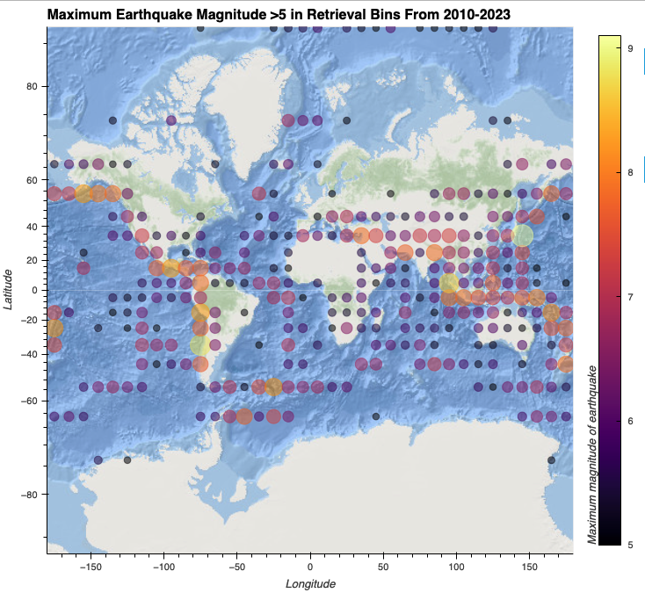
Map Views of Maximum Earthquake Magnitude
Ring of fire on the Pacific Rim

Slide 16
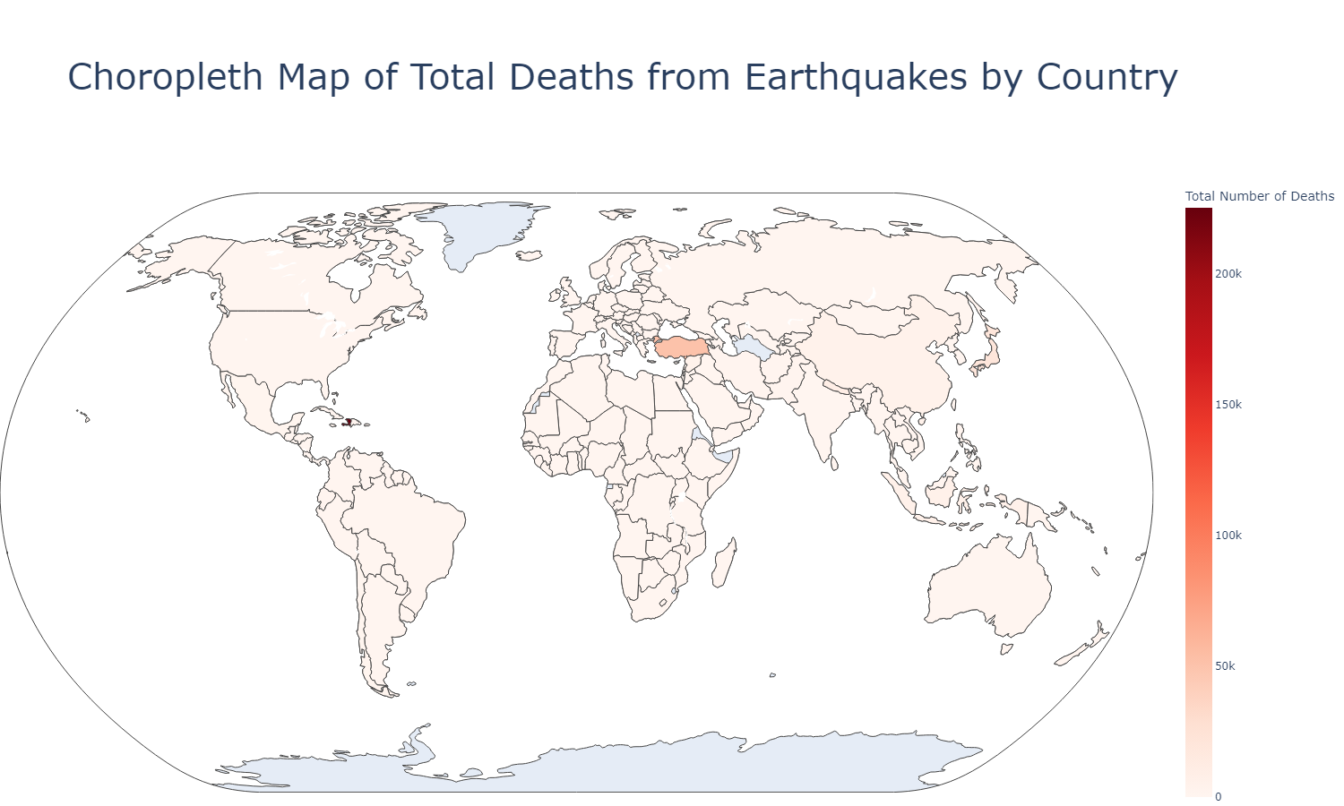
Blue = no data available
Any shade of pink = countries where earthquakes occurred

Slide 17
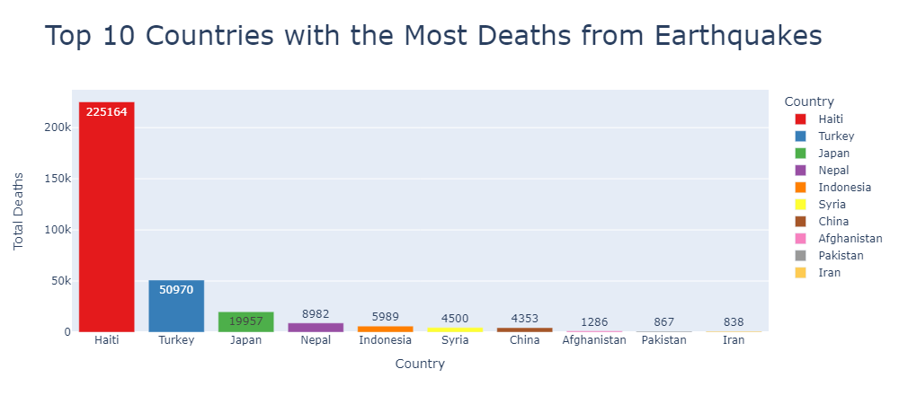
Haiti 225k > Turkey 51k > Japan 20k > Others fewer than 10k each: varying levels of preparedness and the extent of the impact

Slide 18
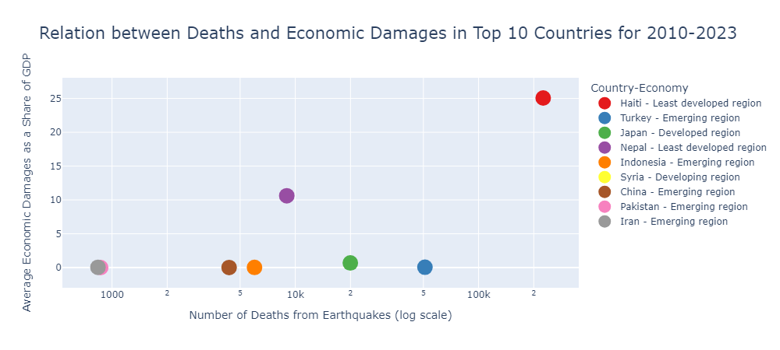
Least developed regions
More economic damage, relative to GDP, seen in less developed regions.

Slide 19
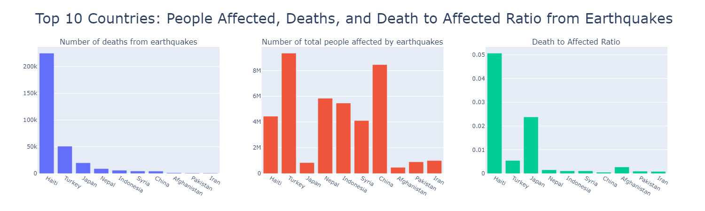
Haiti, a less developed region, stands out with the highest number of deaths and death-to-affected ratio.
Turkey, an emerging region, has the second-highest deaths but a lower death-to-affected ratio, indicating its economic status possibly linked to the region’s preparedness.
China ranks second in total people affected but maintains a low death-to-affected ratio.
Japan, a developed region, has the second-highest death-to-affected ratio, attributed to the highest magnitude level during the specified period.
⇒ Death rates may vary based on economic status, preparedness, and earthquake severity.

Slide 20
Summary & Recommendations
We were able to successfully use the USGS API interface to retrieve >20000 earthquakes from 2010 to 2023
We were successfully able to capture the number of earthquakes across different countries. We ranked these countries by the number of earthquakes and through space & time. We also used an extended boundary of countries to catch earthquakes nearby to other countries which could impact that country
We observed the left skewedness of earthquake magnitude and depth & found that there were no correlations between depth and magnitude
We observed the spatial distribution of maximum magnitude of earthquakes and ranked countries by largest earthquake magnitude experienced.
Effect of earthquakes:
We observed the countries that have the highest cumulative causality rates from earthquakes.
We observed that poorly developed nations suffer greatest economic impact from earthquakes.
The death-to-affected ratio may be influenced to a country’s economic status (preparedness). The Japan outlier suggests that the earthquake magnitude also has a role to play
Recommendations:
Further investigate the link between tidal fluctuations and earthquake occurrence
Broaden the filters out of magnitude and depth

